Slide 1
SONA User Guide
Clay Killingsworth
05-07-2020

Slide 2


Contents
Creating a Study
Recruiting Participants
Data Retrieval

Slide 3
Creating a New Study

Slide 4
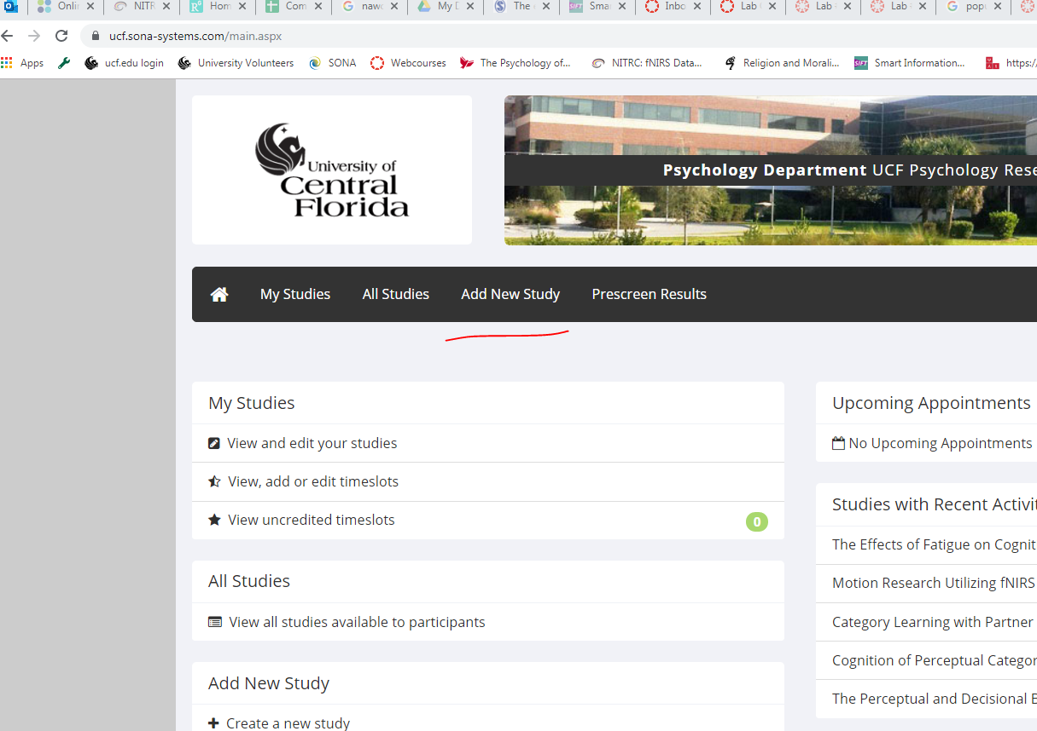
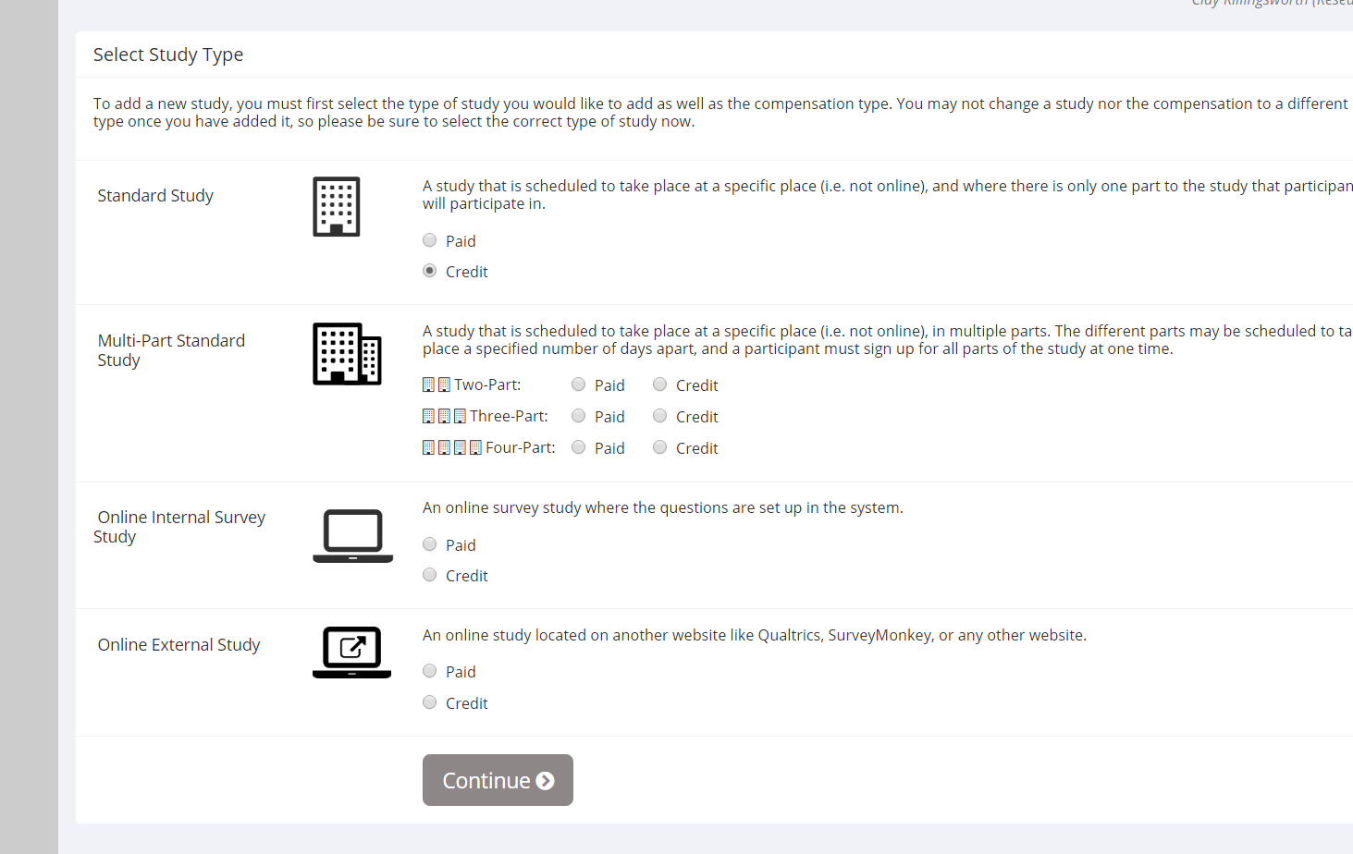
Enter Logistics Information
From SONA homepage go to “Add New Study”
Specify credit/pay, number of sites, and if the study will have online components

Slide 5
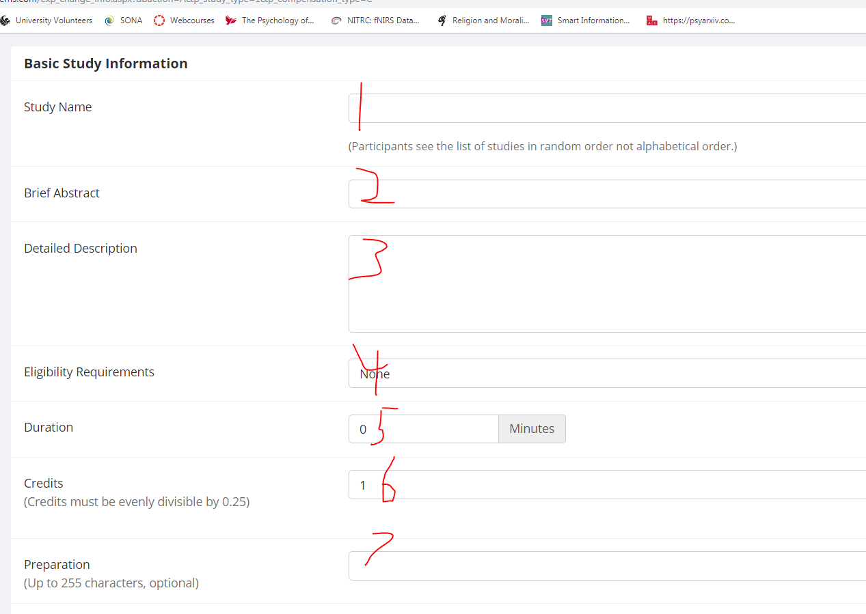
Basic Study Information
IRB Name
Brief Abstract ~1-2 sentences
Longer description
Eligibility requirements text box is only for participant information, disqualifiers will be specified later
Duration (informational only)
Credits (1 credit = 1 hour)
Preparation (usually omitted)

Slide 6
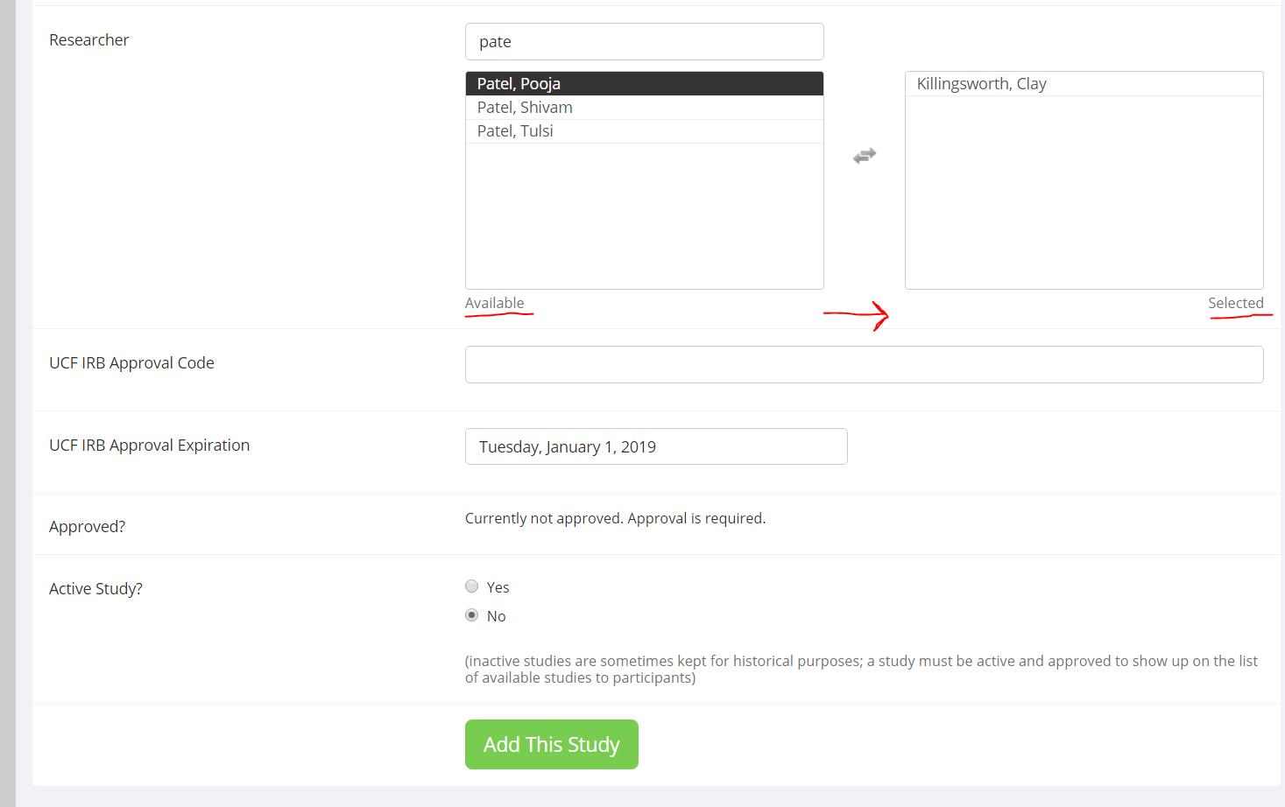
Basic Study Information
Add researchers (RA’s) by searching name and clicking the tile to move from “Available” to “Selected”
Enter UCF IRB Approval Code and Expiration Date from outcome letter
Select “Yes” for active – will be visible as soon as the study is approved by SONA
Don’t click the green “Add” button yet!

Slide 7
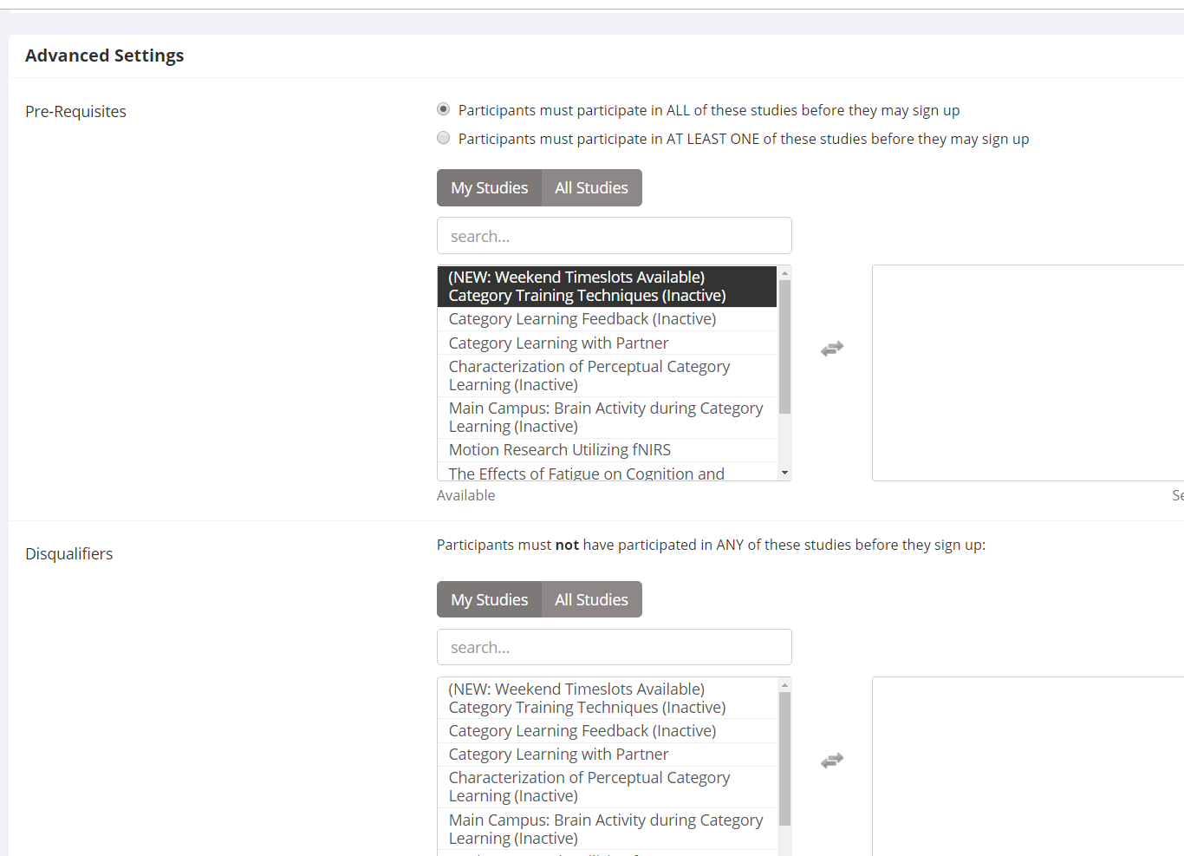
Advanced Settings
If there’s a prerequisite study or a disqualifying study for participation in the new one, specify here.
Note: Only open studies can be added here. They don’t have to be “Active”, but they have to still be on SONA

Slide 8
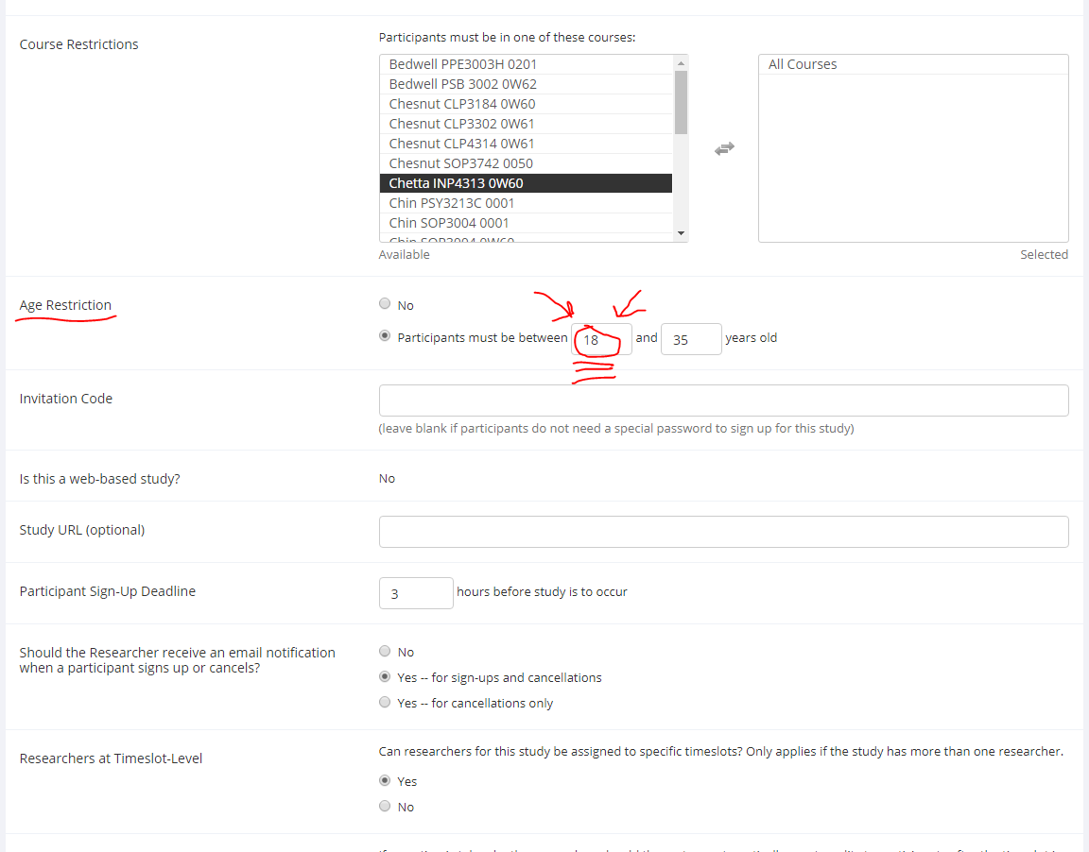
Advanced Settings
Enter course restrictions (e.g., must be enrolled in PSY XXXX)
SPECIFY AGE RESTRICTION – system doesn’t automatically exclude <18 y.o.
Invitation Code – if you want to restrict signups
Signup Deadline – only relevant for in-person studies. Don’t go lower than 3h
Notification preferences
Assign RA’s to specific timeslots? (only relevant for in-person studies)

Slide 9
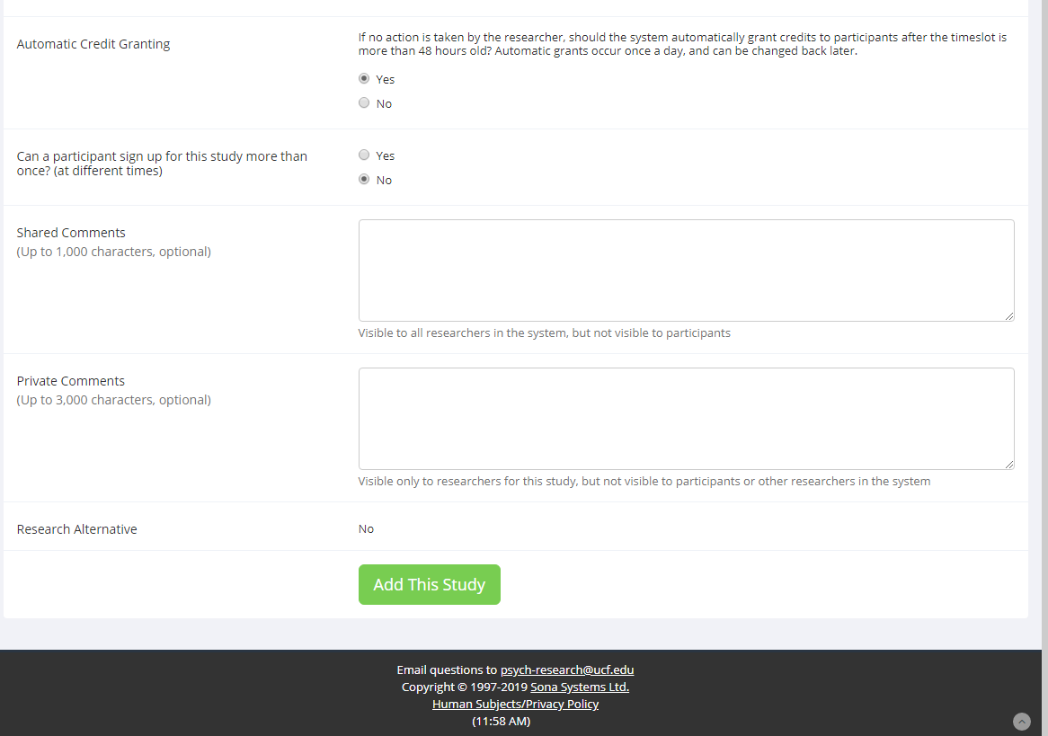
Advanced Settings
Automatic Credit Granting in case you forget? Yes
Repeat participants? Probably No
Additional information (Shared is for all researchers to see, Private is for only researchers on this study) [optional]
Click Add This Study

Slide 10
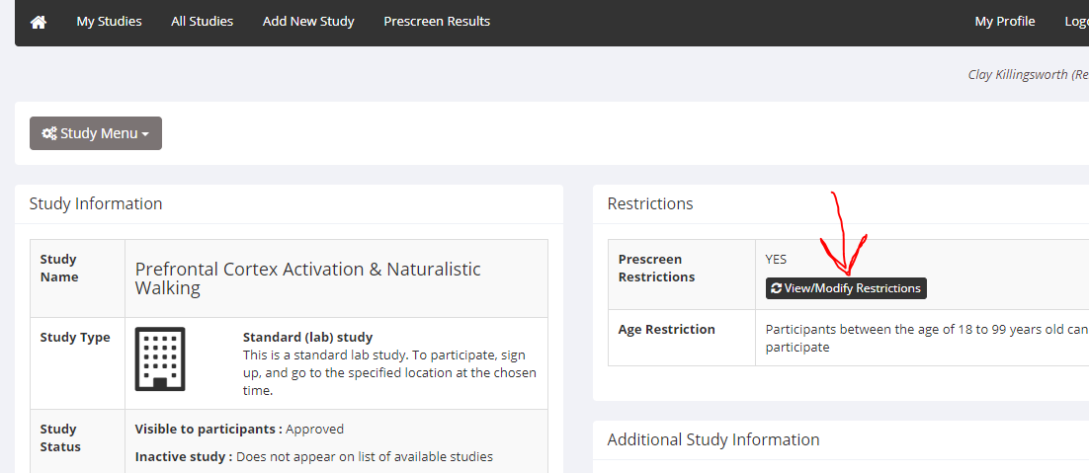
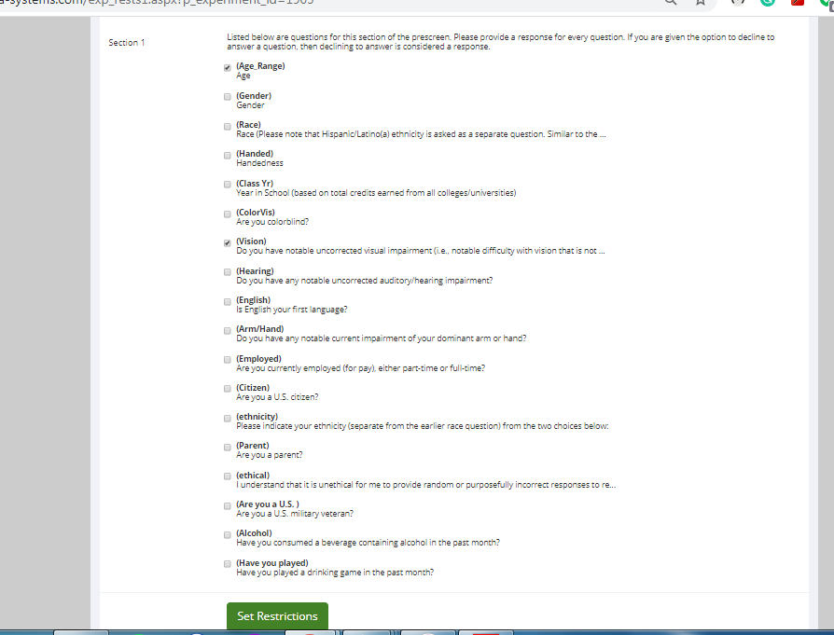
Confirm Prescreen Restrictions
On the study home page, select View/Modify Restrictions
Ensure the correct characteristics are selected (age, vision, etc.) and Set Restrictions

Slide 11
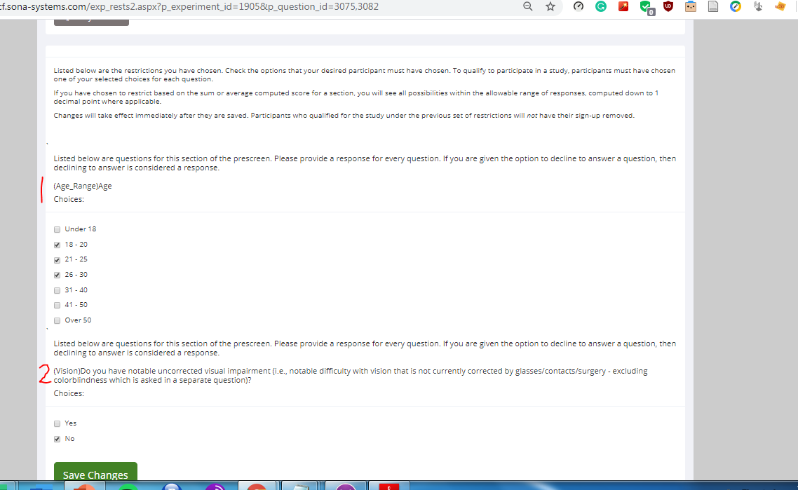
Confirm Prescreen Restrictions
For each characteristic, select the responses that will be ALLOWED in your study. These are for inclusion, not exclusion

Slide 12
Study Approval and Activation

Slide 13
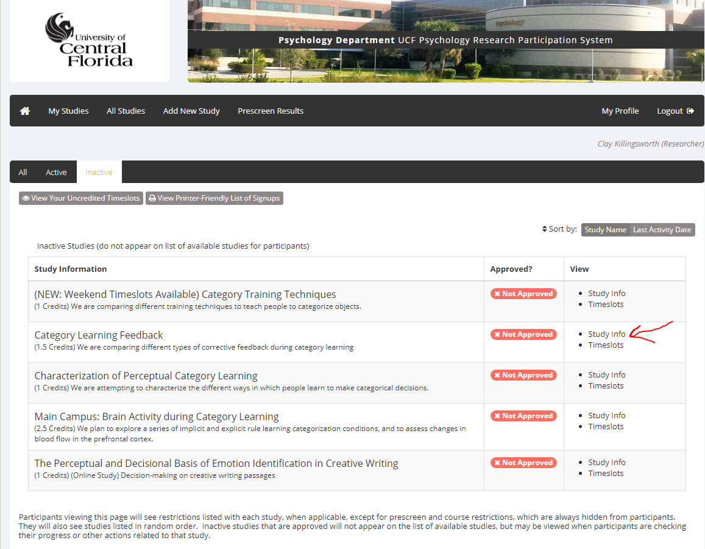
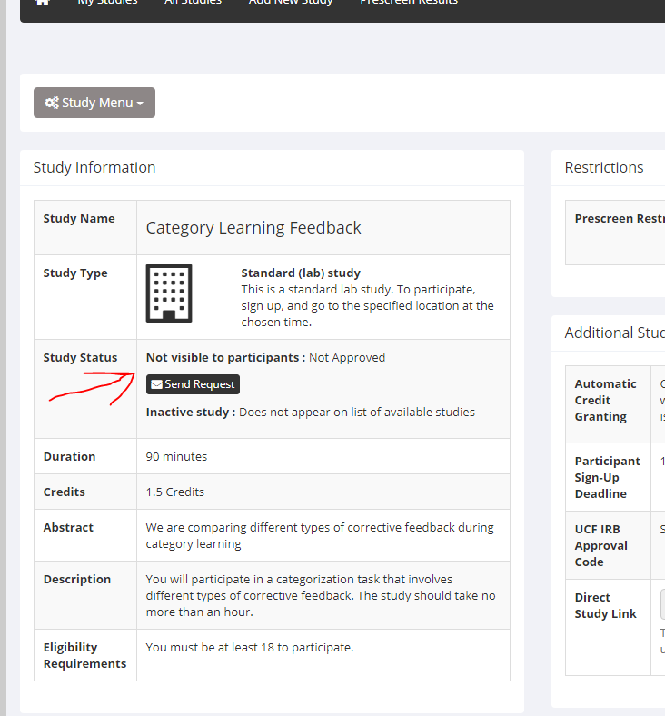
Approval
Go to My Studies tab
Select Study Info
Under Study Status, select Send Request

Slide 14
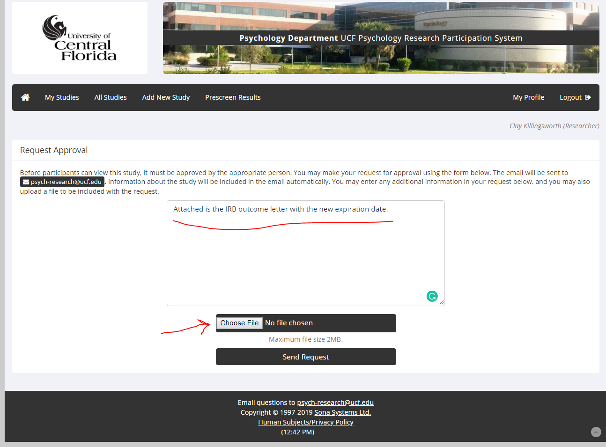
Approval
Note that there is an attachment
Attach the outcome letter showing the new expiration date from the IRB
Send

Slide 15
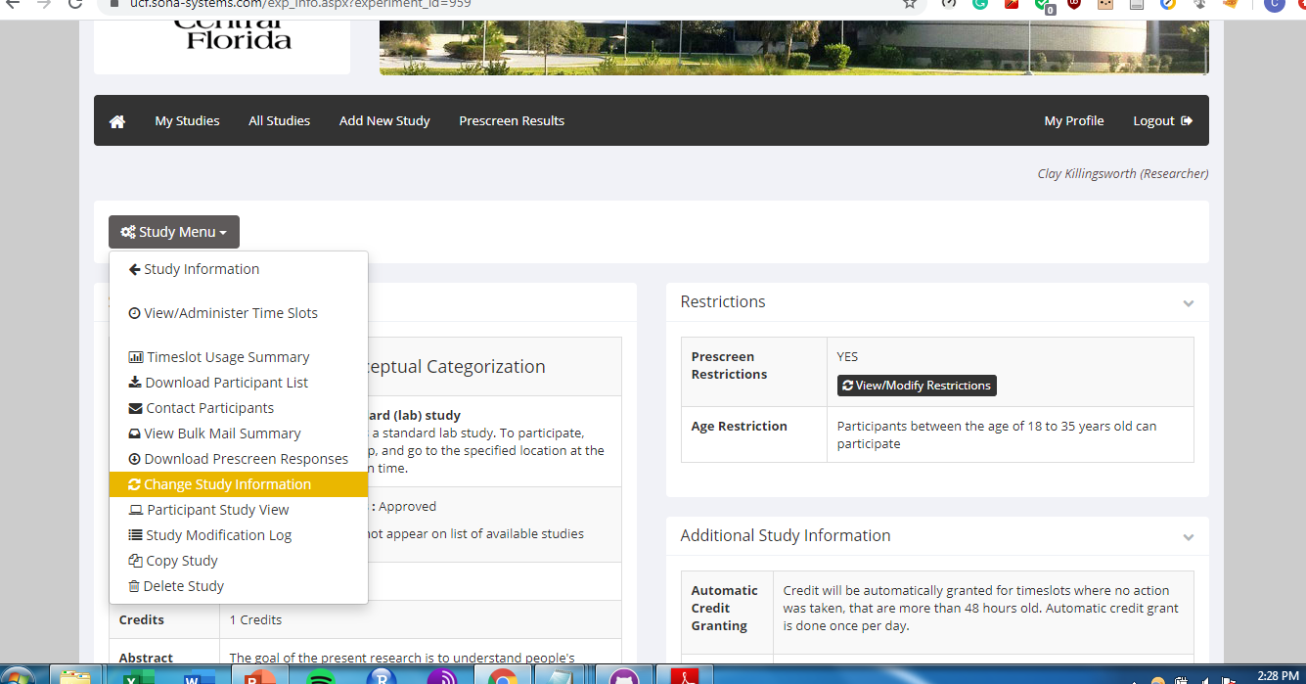
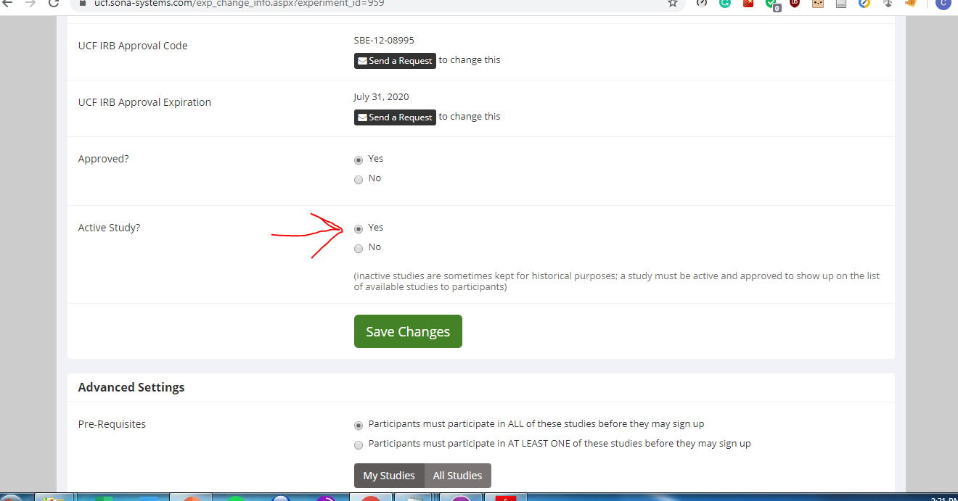
Activation
Once notified (by email) that the study has been approved, you can set the study to Active. Only active studies can be viewed by participants
My Studies → All → select your study → Study Menu → Change Study Information
Set “Active Study” to Yes
Save Changes
Important: Approval is done by SONA administrators; activation is done by the researcher. So, once you receive approval you still must make the study active before signups can start.

Slide 16
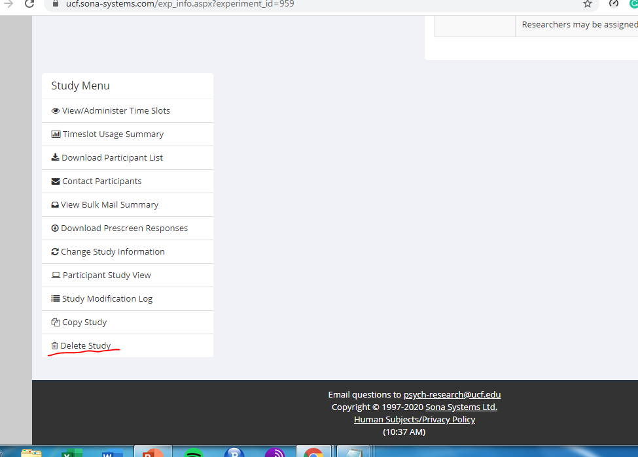
Removing a Study
Once a study has finished data collection, it should be made inactive (prior slide).
Once a study is completed, it can be deleted from SONA (right).

Slide 17
Recruiting Participants

Slide 18
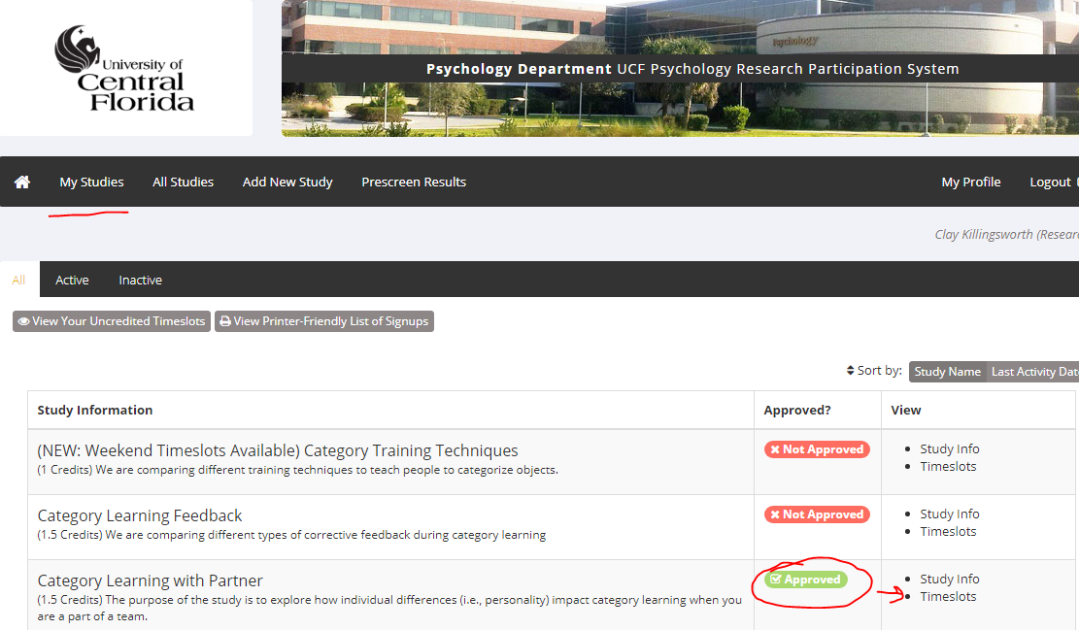
Activation
Once study is set to active, participants can see it and sign up.
Time to add timeslots!

Slide 19
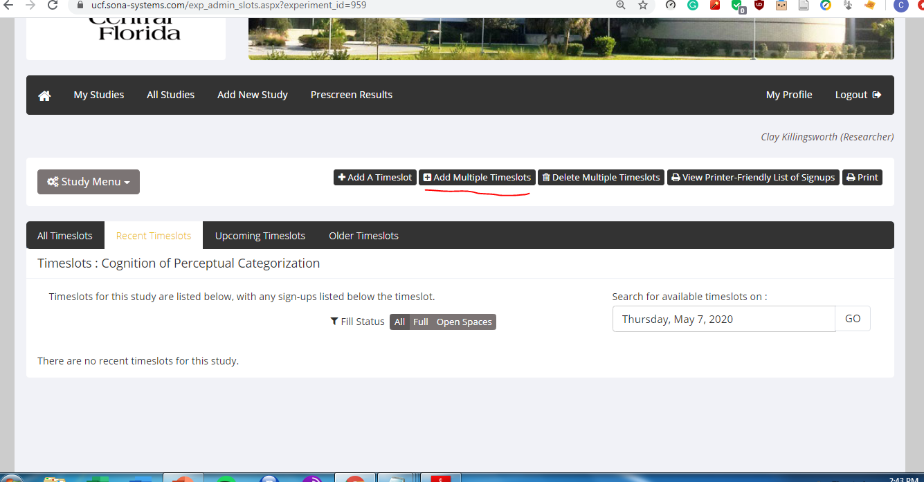
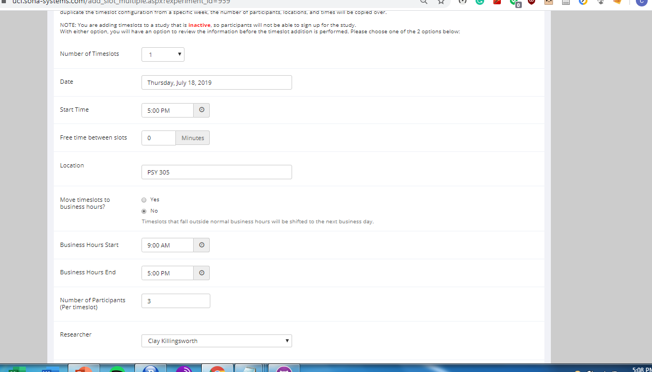
New Timeslots
It’s usually easiest to add multiple timeslots in one go, unless something needs to change between slots (e.g., assigned researcher).
Select a number of timeslots, date, start time (of the first slot)
Successive slots begin at intervals equal to the length of the study – adding slots to a 90 minute study yields start times of 9:00, 10:30, 12:00, etc. – unless free time is added between
Select # of participants per slot
Location is always PSY 305
Assign researcher (for in-person, the RA scheduled for that time; else, the grad student/PI)
After you select Add the new timeslots are displayed for edits /confirmation

Slide 20
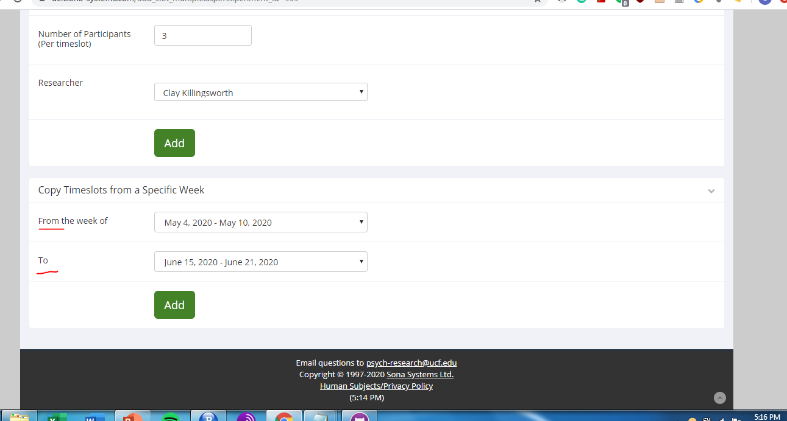
Copying Timeslots
If you don’t need to change much about the schedule from a prior week, you can use Copy Timeslots to populate new timeslots with the settings from a past week
Useful when the RA schedule hasn’t changed and data collection is in full swing
Select the week to copy (From) and the future week (To)

Slide 21

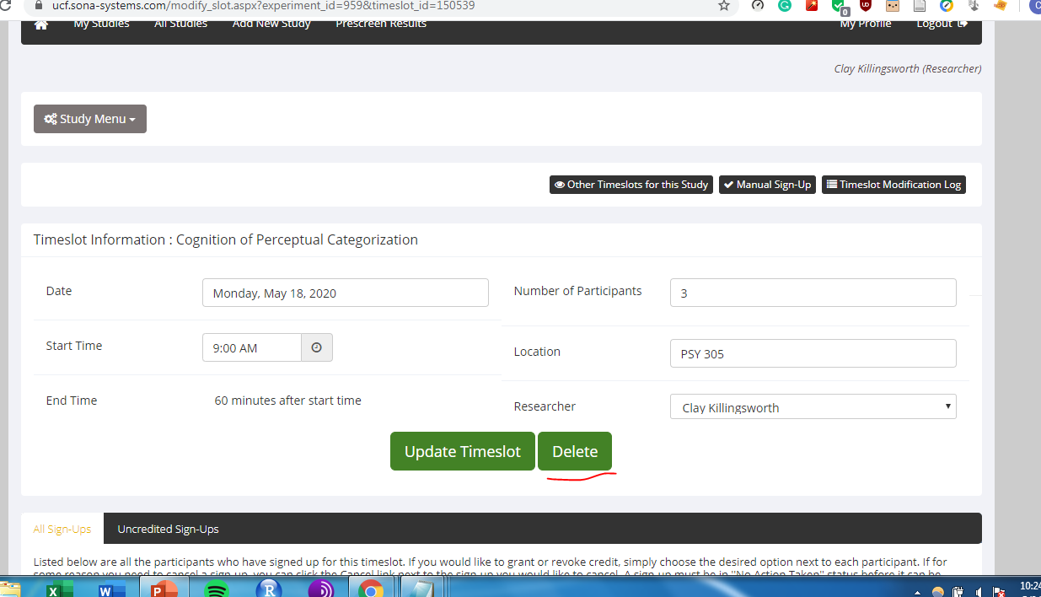
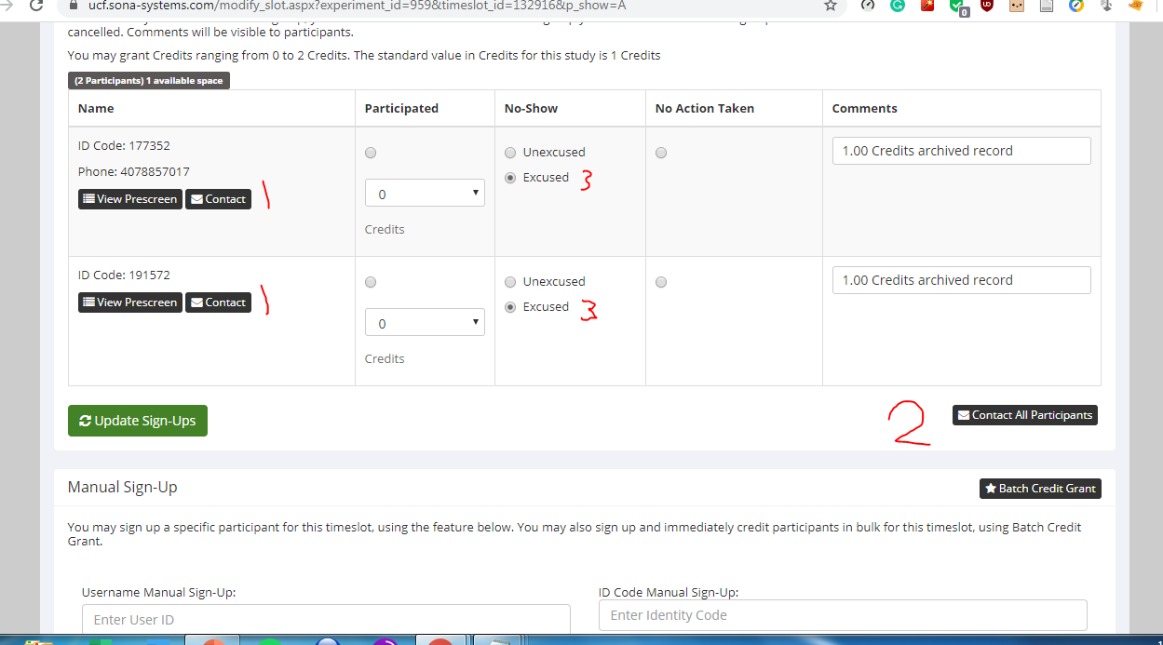
Cancelling Timeslots
Timeslots can be deleted if no one has signed up yet.
If there is a signup already, you’ll need to contact the participant (1,2) to inform them of the change and update their status to “Excused No-Show” (3)
Note: Cancellations must be done > 24 hours before the start time or we have to give them credit for participation

Slide 22
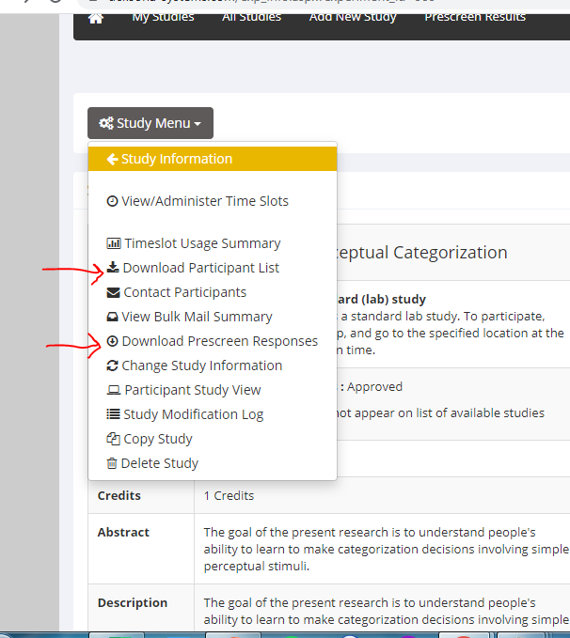
Participant Data
Participant data is available from the Study Menu
A list of participants can be downloaded viewed or downloaded as a .csv
Demographics are available via “Prescreen Responses”
Note: Prescreen responses may or may not be up to date, including age. It’s always good practice to ask your own demographic questions

Slide 23
FIN

